Slide 1
Module 5
Groups

Slide 2
Announcements

Slide 3
Attendance
bit.ly/attend8

Slide 4
Apply with Multiple Arguments

Slide 5
Apply
The apply method creates an array by calling a function on every element in one or more input columns
First argument: Function to apply
Other arguments: The input column(s)
table_name.apply(one_arg_function, 'column_label')
table_name.apply(two_arg_function,
'column_label_for_first_arg',
'column_label_for_second_arg')
apply called with only a function applies it to each row
(Demo)

Slide 6
Grouping Rows

Slide 7
Group
The group method aggregates all rows with the same value for a column into a single row in the result
First argument: Which column to group by
Second argument: (Optional) How to combine values
len — number of grouped values (default)
sum — total of all grouped values
list — list of all grouped values
(Demo)

Slide 8
Grouping By Two Columns
The group method can also aggregate all rows that share the combination of values in multiple columns
First argument: A list of which columns to group by
Second argument: (Optional) How to combine values
(Demo)

Slide 9
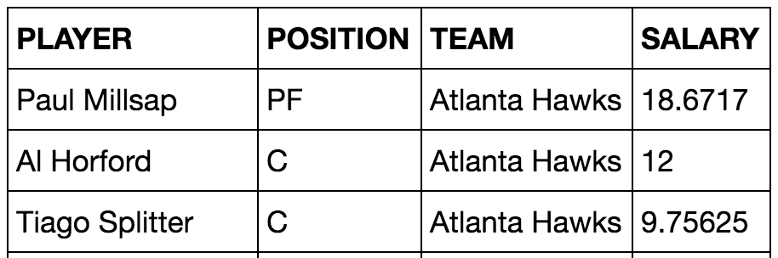
Challenge Question
Which NBA teams spent the most on their starters in 2016?
Each team has one starter per position
Assume the starter for a team & position is the player with the highest salary on that team in that position

Slide 10
Pivot Tables

Slide 11
Pivot
Cross-classifies according to two categorical variables
Produces a grid of counts or aggregated values
Two required arguments:
First: variable that forms column labels of grid
Second: variable that forms row labels of grid
Two optional arguments (include both or neither)
values=’column_label_to_aggregate’
collect=function_with_which_to_aggregate
(Demo)

Slide 12
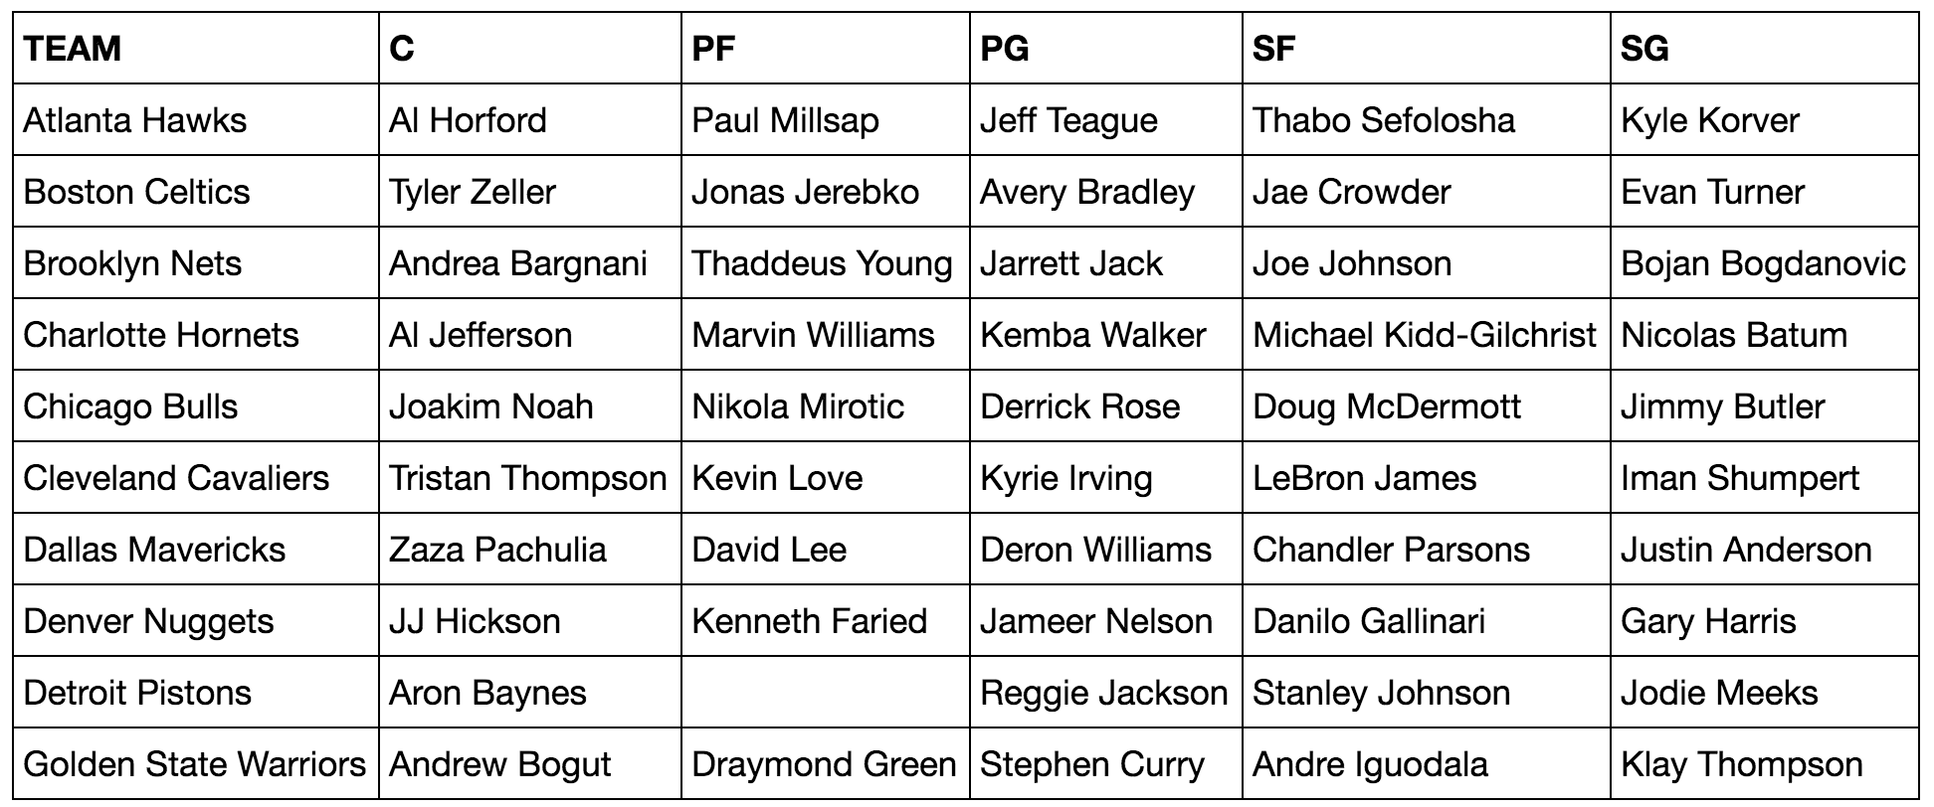
Take-Home Question
Generate a table of the names of the starters for each team

Slide 13
Module 5
Joins

Slide 14
Announcements

Slide 15
Attendance
bit.ly/attend8

Slide 16
Joins

Slide 17
Joining Two Tables
drinks.join('Cafe', discounts, 'Location')
Keep all rows in the table that have a match ...
… for the value in this column ...
… somewhere in this other table's ...
… column that contains matching values.
drinks
discounts
Drink | Cafe | Price
Milk Tea | Tea One | 4
Espresso | Nefeli | 2
Latte | Nefeli | 3
Espresso | Abe's | 2
Coupon | Location
25% | Tea One
50% | Nefeli
5% | Tea One
Cafe | Drink | Price | Coupon
Nefeli | Espresso | 2 | 50%
Nefeli | Latte | 3 | 50%
Tea One | Milk Tea | 4 | 25%
Tea One | Milk Tea | 4 | 5%
The joined column is sorted automatically
(Demo)

Slide 18
Bikes

Slide 19
Maps

Slide 20
Maps
A table containing columns of latitude and longitude values can be used to generate a map of markers
_______.map_table(table, ...)
Either Marker or Circle
Column 0: latitudes
Column 1: longitudes
Column 2: labels
Column 3: colors
Column 4: sizes
Applies to all features:
color='blue'
size=200

Slide 21
Module 5
Table Examples

Slide 22
Announcements

Slide 23
Attendance
bit.ly/attend8

Slide 24
Combining Table Methods

Slide 25
Important Table Methods
t.select(column, …) or t.drop(column, …)
t.take([row, …]) or t.exclude([row, …])
t.sort(column, descending=False, distinct=False)
t.where(column, are.condition(...))
t.apply(function, column, …)
t.group(column) or t.group(column, function)
t.group([column, …]) or t.group([column, …], function)
t.pivot(cols, rows) or t.pivot(cols, rows, vals, function)
t.join(column, other_table, other_table_column)

Slide 26
Discussion Question
Generate a table with one row per cafe that has the name and discounted price of its cheapest discounted drink
drinks
discounts
cheapest
Drink | Cafe | Price
Milk Tea | Tea One | 4
Espresso | Nefeli | 2
Coffee | Nefeli | 3
Espresso | Abe's | 2
Coupon | Location
5% | Tea One
50% | Nefeli
25% | Tea One
Cafe | Drink | Discounted Price
Nefeli | Espresso | 1
Tea One | Milk Tea | 3

Slide 27
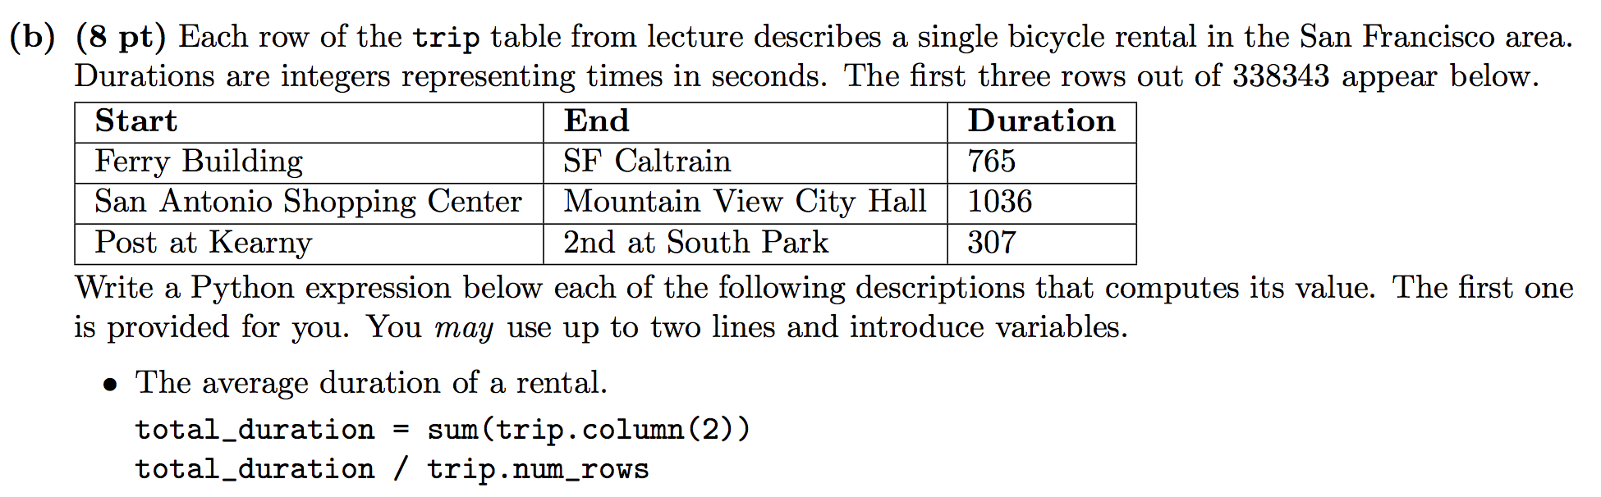
Spring 2016 Midterm, Q2(b)
The name of the station where the most rentals ended (assume no ties).
The number of stations for which the average duration ending at that station was more than 10 minutes.

Slide 28
Advanced Where (Optional)

Slide 29
Comparison Operators
The result of a comparison expression is a bool value
x = 2 y = 3
x > 1 x > y y >= 3
x == y x != 2 2 < x < 5
Assignment statements
Comparison expressions
t.where(array_of_bool_values) returns a table with only the rows of t for which the corresponding bool is True.
(Demo)

Slide 30
Tax Returns & ZIP Codes
(Demo)

Slide 31
Module 5
Iteration

Slide 32
Announcements

Slide 33
Attendance
bit.ly/attend8

Slide 34
Comparison

Slide 35
Comparison Operators
The result of a comparison expression is a bool value
x = 2 y = 3
x > 1 x > y y >= 3
x == y x != 2 2 < x < 5
Assignment statements
Comparison expressions
(Demo)

Slide 36
Combining Comparisons
Boolean operators can be applied to bool values
a = True b = False
not b a or b a and not b
a and b not (a or b) b and b
Evaluate to True
Evaluate to False
(Demo)

Slide 37
Aggregating Comparisons
Summing an array or list of bool values will count the True values only.
1 + 0 + 1 == 2
True + False + True == 2
sum([1 , 0 , 1 )) == 2
sum([True, False, True)) == 2
(Demo)

Slide 38
Random Selection

Slide 39
Random Selection
np.random.choice
Selects at random
with replacement
from an array
a specified number of times
np.random.choice(some_array, sample_size)
(Demo)

Slide 40
Discussion Question
d = np.arange(6) + 1
What results from evaluating the following 2 expressions? Are they the same? Do they describe the same process?
np.random.choice(d, 1000) + np.random.choice(d, 1000)
2 * np.random.choice(d, 1000)

Slide 41
The Print Function
(Demo)

Slide 42
Control Statements

Slide 43
Control Statements
These statements control the sequence of computations that are performed in a program
The keywords if and for begin control statements
The purpose of if is to define functions that choose different behavior based on their arguments
The purpose of for is to perform a computation for every element in a list or array
(Demo)

Slide 44
Module 5
Chance

Slide 45
Announcements

Slide 46
The Monty Hall Problem

Slide 47
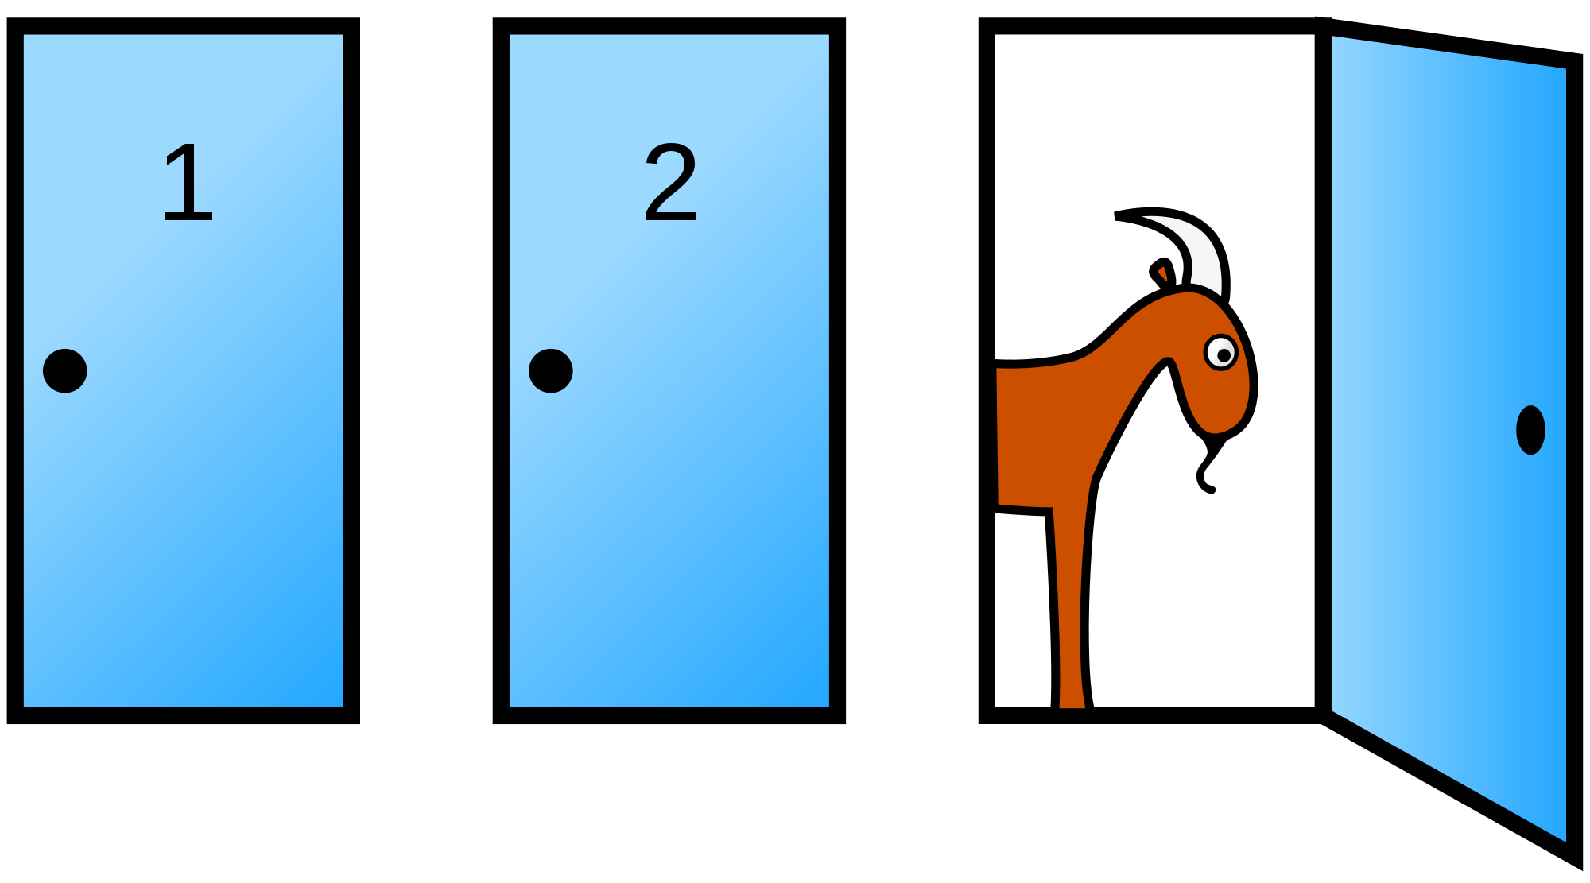
Monty Hall Problem

Slide 48
Attendance
bit.ly/attend8

Slide 49
Probability

Slide 50
Probability
Lowest value: 0
Chance of event that is impossible
Highest value: 1 (or 100%)
Chance of event that is certain
If an event has chance 70%, then the chance that it doesn’t happen is
100% - 70% = 30%
1 - 0.7 = 0.3
(Demo)

Slide 51
Equally Likely Outcomes
Assuming all outcomes are equally likely, the chance of an event A is:
number of outcomes that make A happen
P(A) = ---------------------------------------------------------------
total number of outcomes

Slide 52
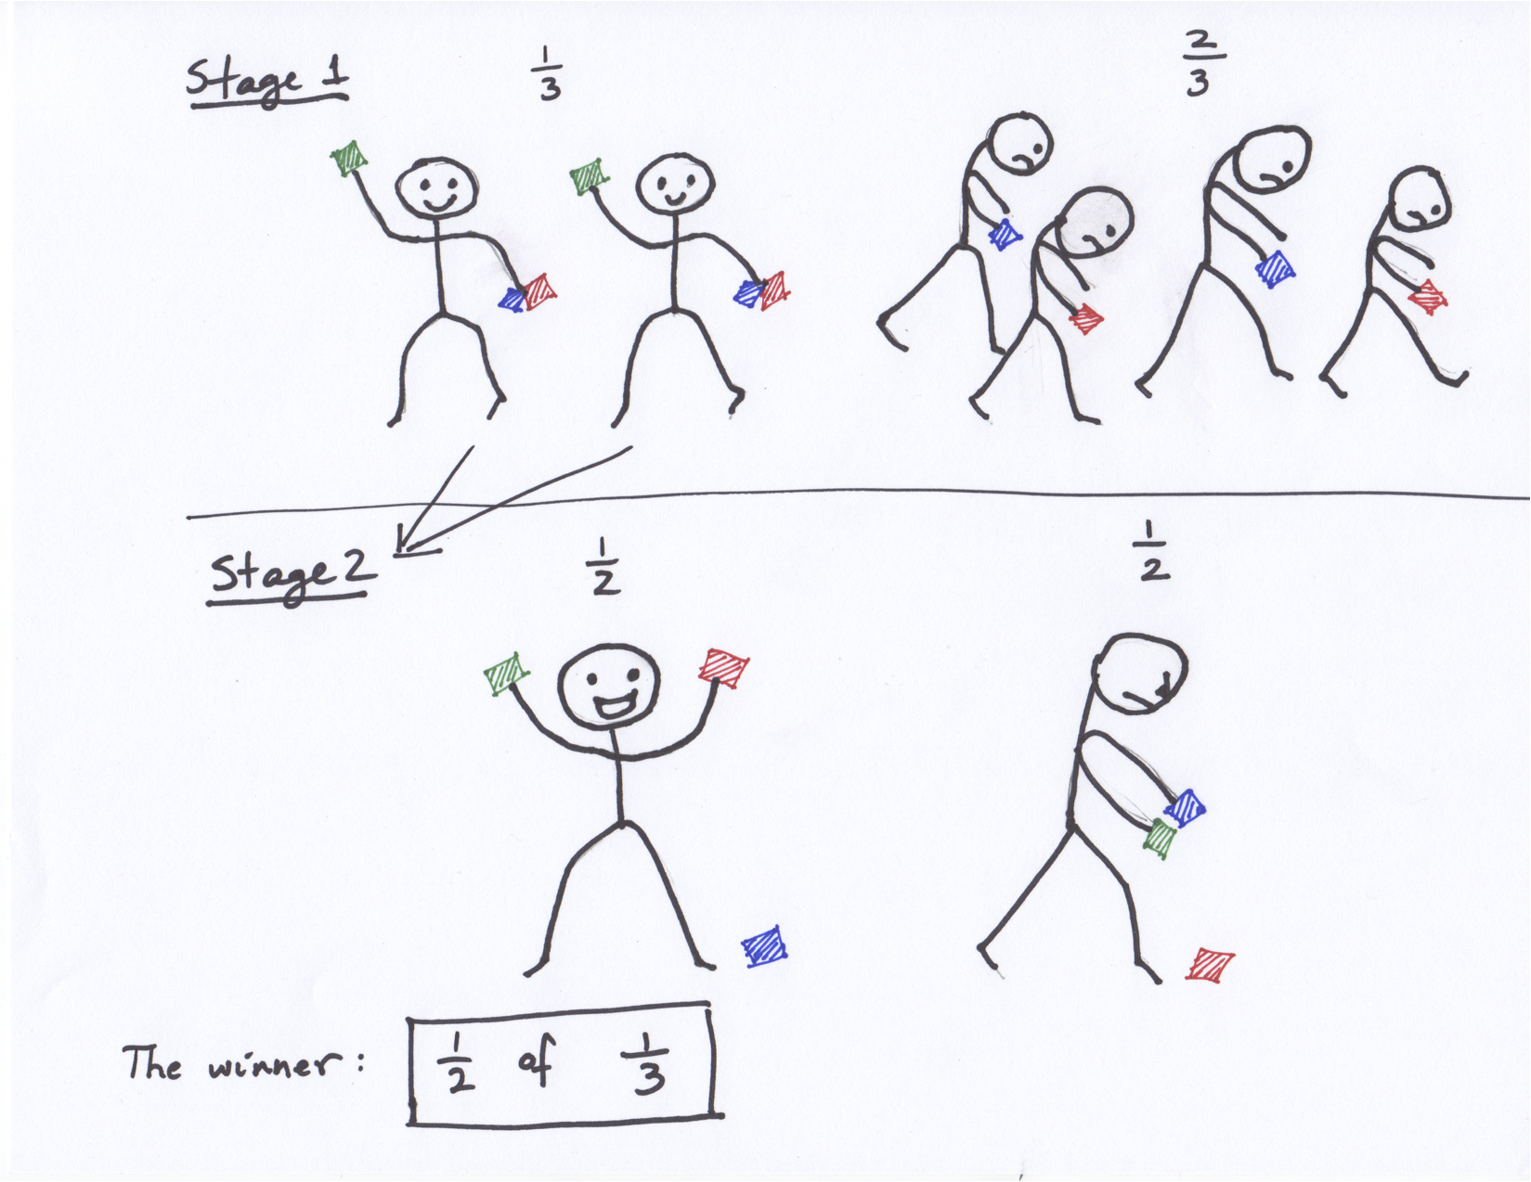
Fraction of a Fraction
(Demo)

Slide 53
Multiplication Rule
Chance that two events A and B both happen
= P(A happens) x P(B happens given that A has happened)
The answer is less than or equal to each of the two chances being multiplied
The more conditions you have to satisfy, the less likely you are to satisfy them all
(Demo)

Slide 54
Addition Rule
If event A can happen in exactly one of two ways, then
P(A) = P(first way) + P(second way)
The answer is greater than or equal to the chance of each individual way

Slide 55
Example: At Least One Head
In 3 tosses:
Any outcome except TTT
P(TTT) = (½) x (½) x (½) = ⅛
P(at least one head) = 1 - P(TTT) = ⅞ = 87.5%
In 10 tosses:
1 - (½)**10
99.9%
(Demo)

